Slide 1
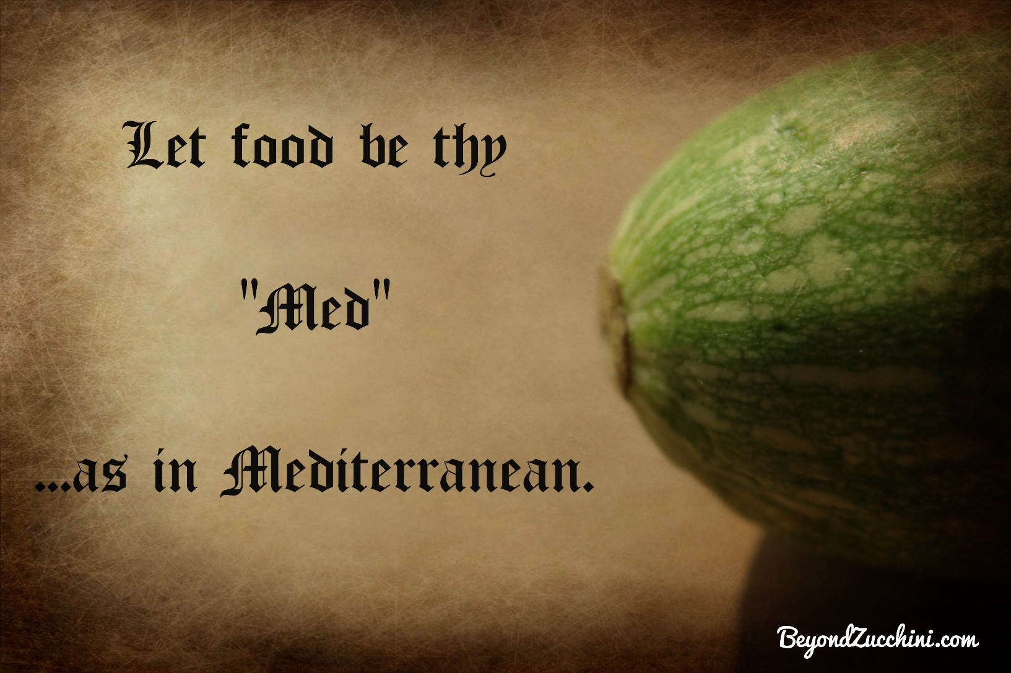
Beyond Zucchini: Superfoods in Traditional Mediterranean Dishes

Slide 2
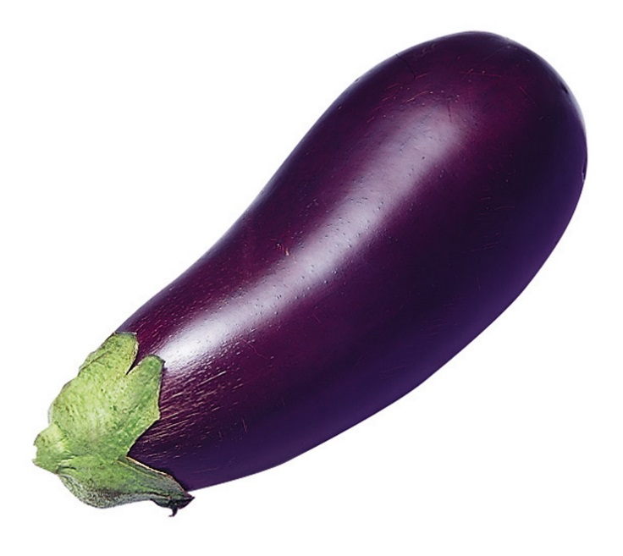
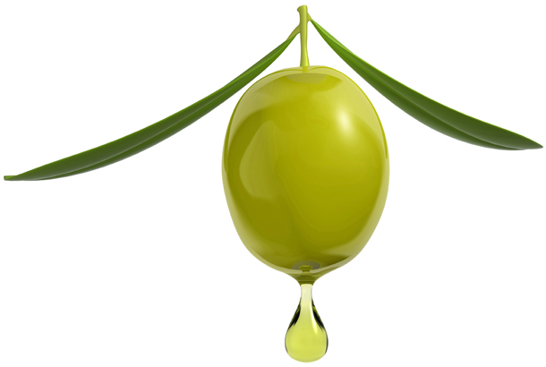
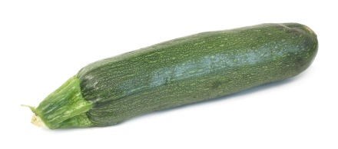
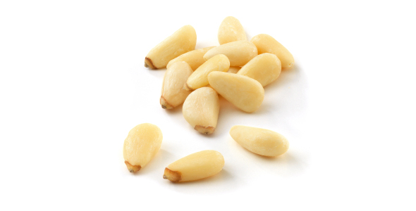

Slide 3
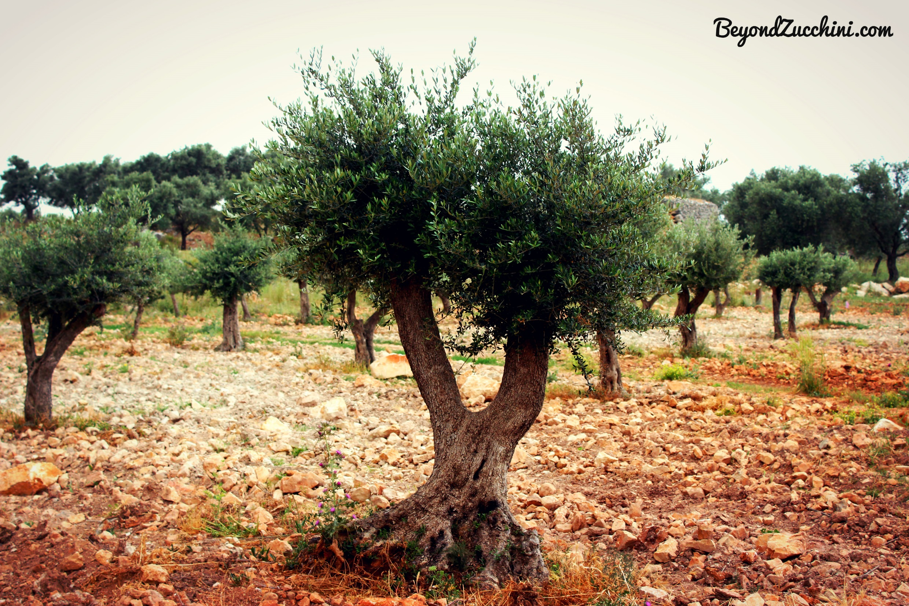

Slide 4
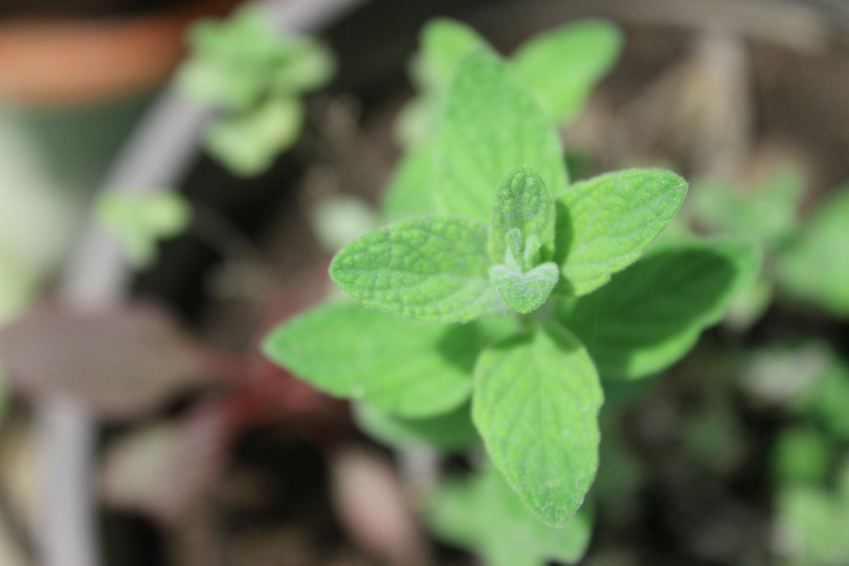
Oregano
1. Thymol and Carvacrol, 2 effective anti-bacterials:
highly effective against 41 strains of the food pathogen, listeria.
Effective in treating infections against giardia lamblia.
Moreover, further studies have proven its ability to kill the hospital superbug MRSA, which is resistant to many antibiotics.
2. 2 potent antioxidants: Rosmarinic acid and Thymol According to the Journal of Nutrition, oregano is one of the herbs with the highest concentration of antioxidants
3. Anti-inflammatory properties: Beta-Caryophyllin, an anti-inflammatory in oregano which may protect against osteoporosis and arteriosclerosis.
4. Protection against cancer: Biologists have been able to show the anti-cancer properties of oregano through encouraging cancer cell apoptosis (in other words, cancer cells commit suicide).
5. Nutritionwise: oregano is a great source of vitamin K and manganese, as well as iron and calcium.

Slide 5
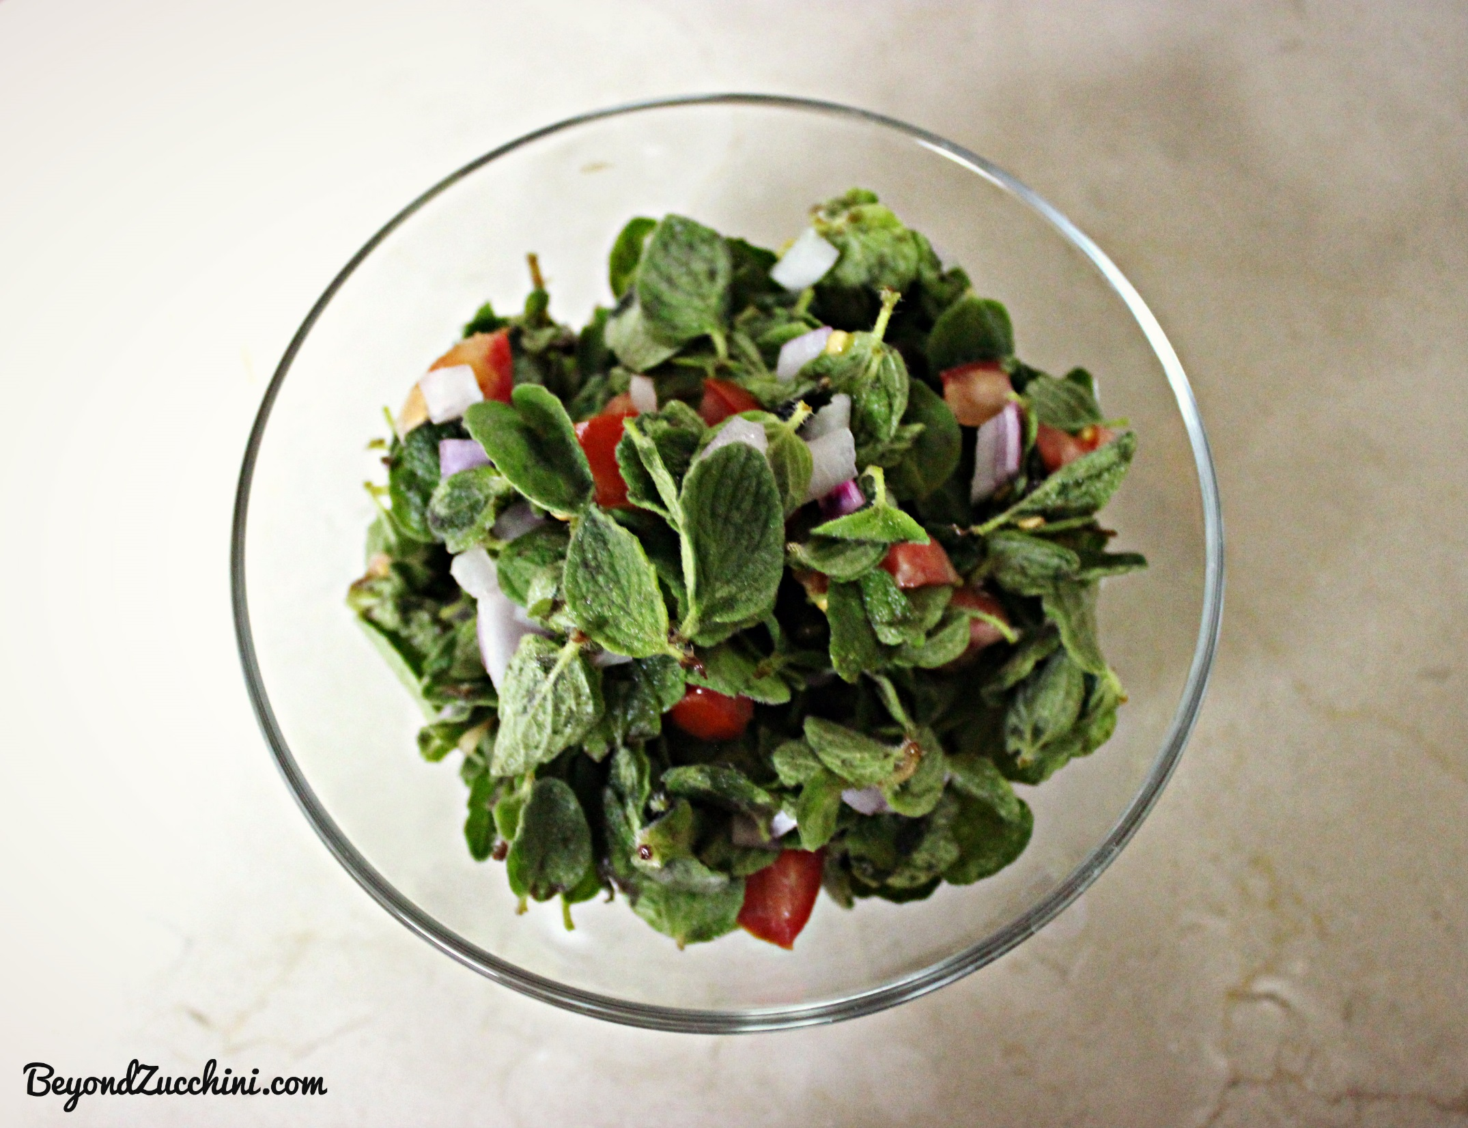
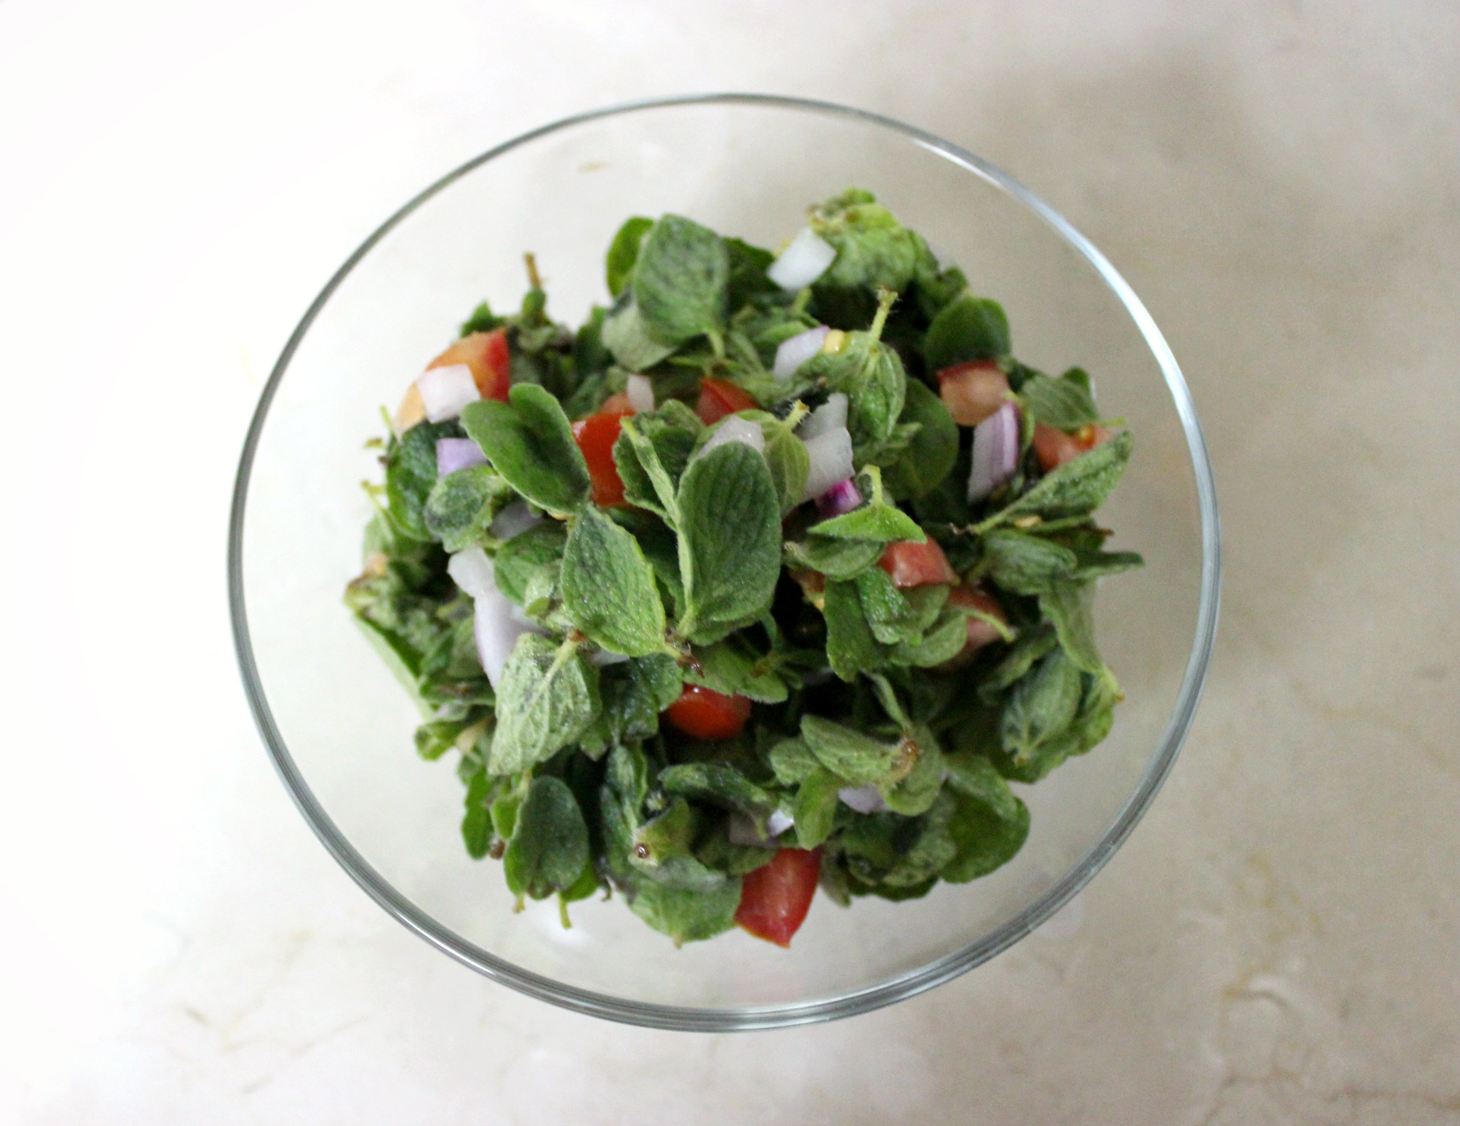

Slide 6
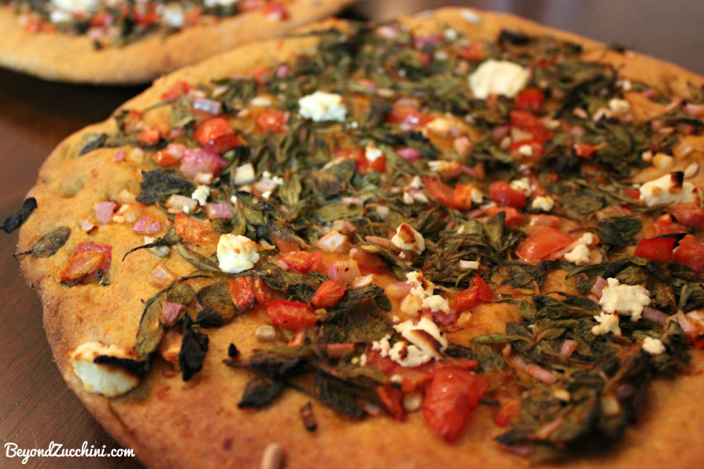

Slide 7
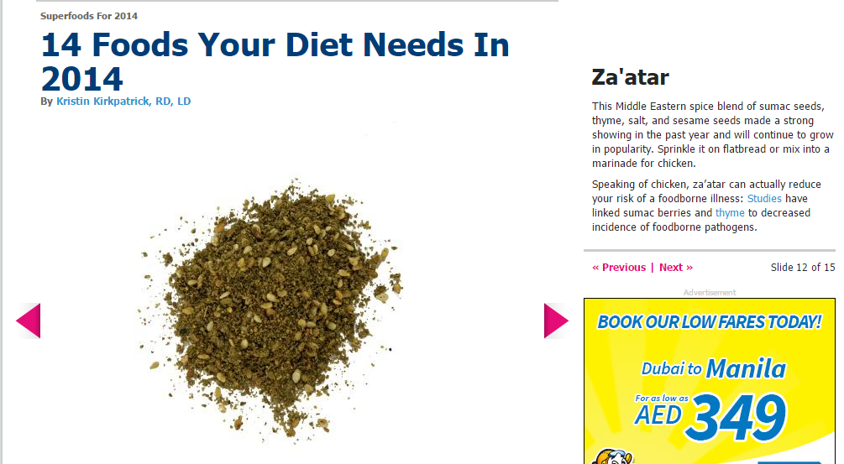
Zaatar (with Sumac)
Antioxidants
Protects against foodbourn allergies
Rich in oils (geraniol, borneo, carvacolo and thymol) that help relieve respiratory problems
Anti-inflammatory (rheumatoid arthritis)

Slide 8
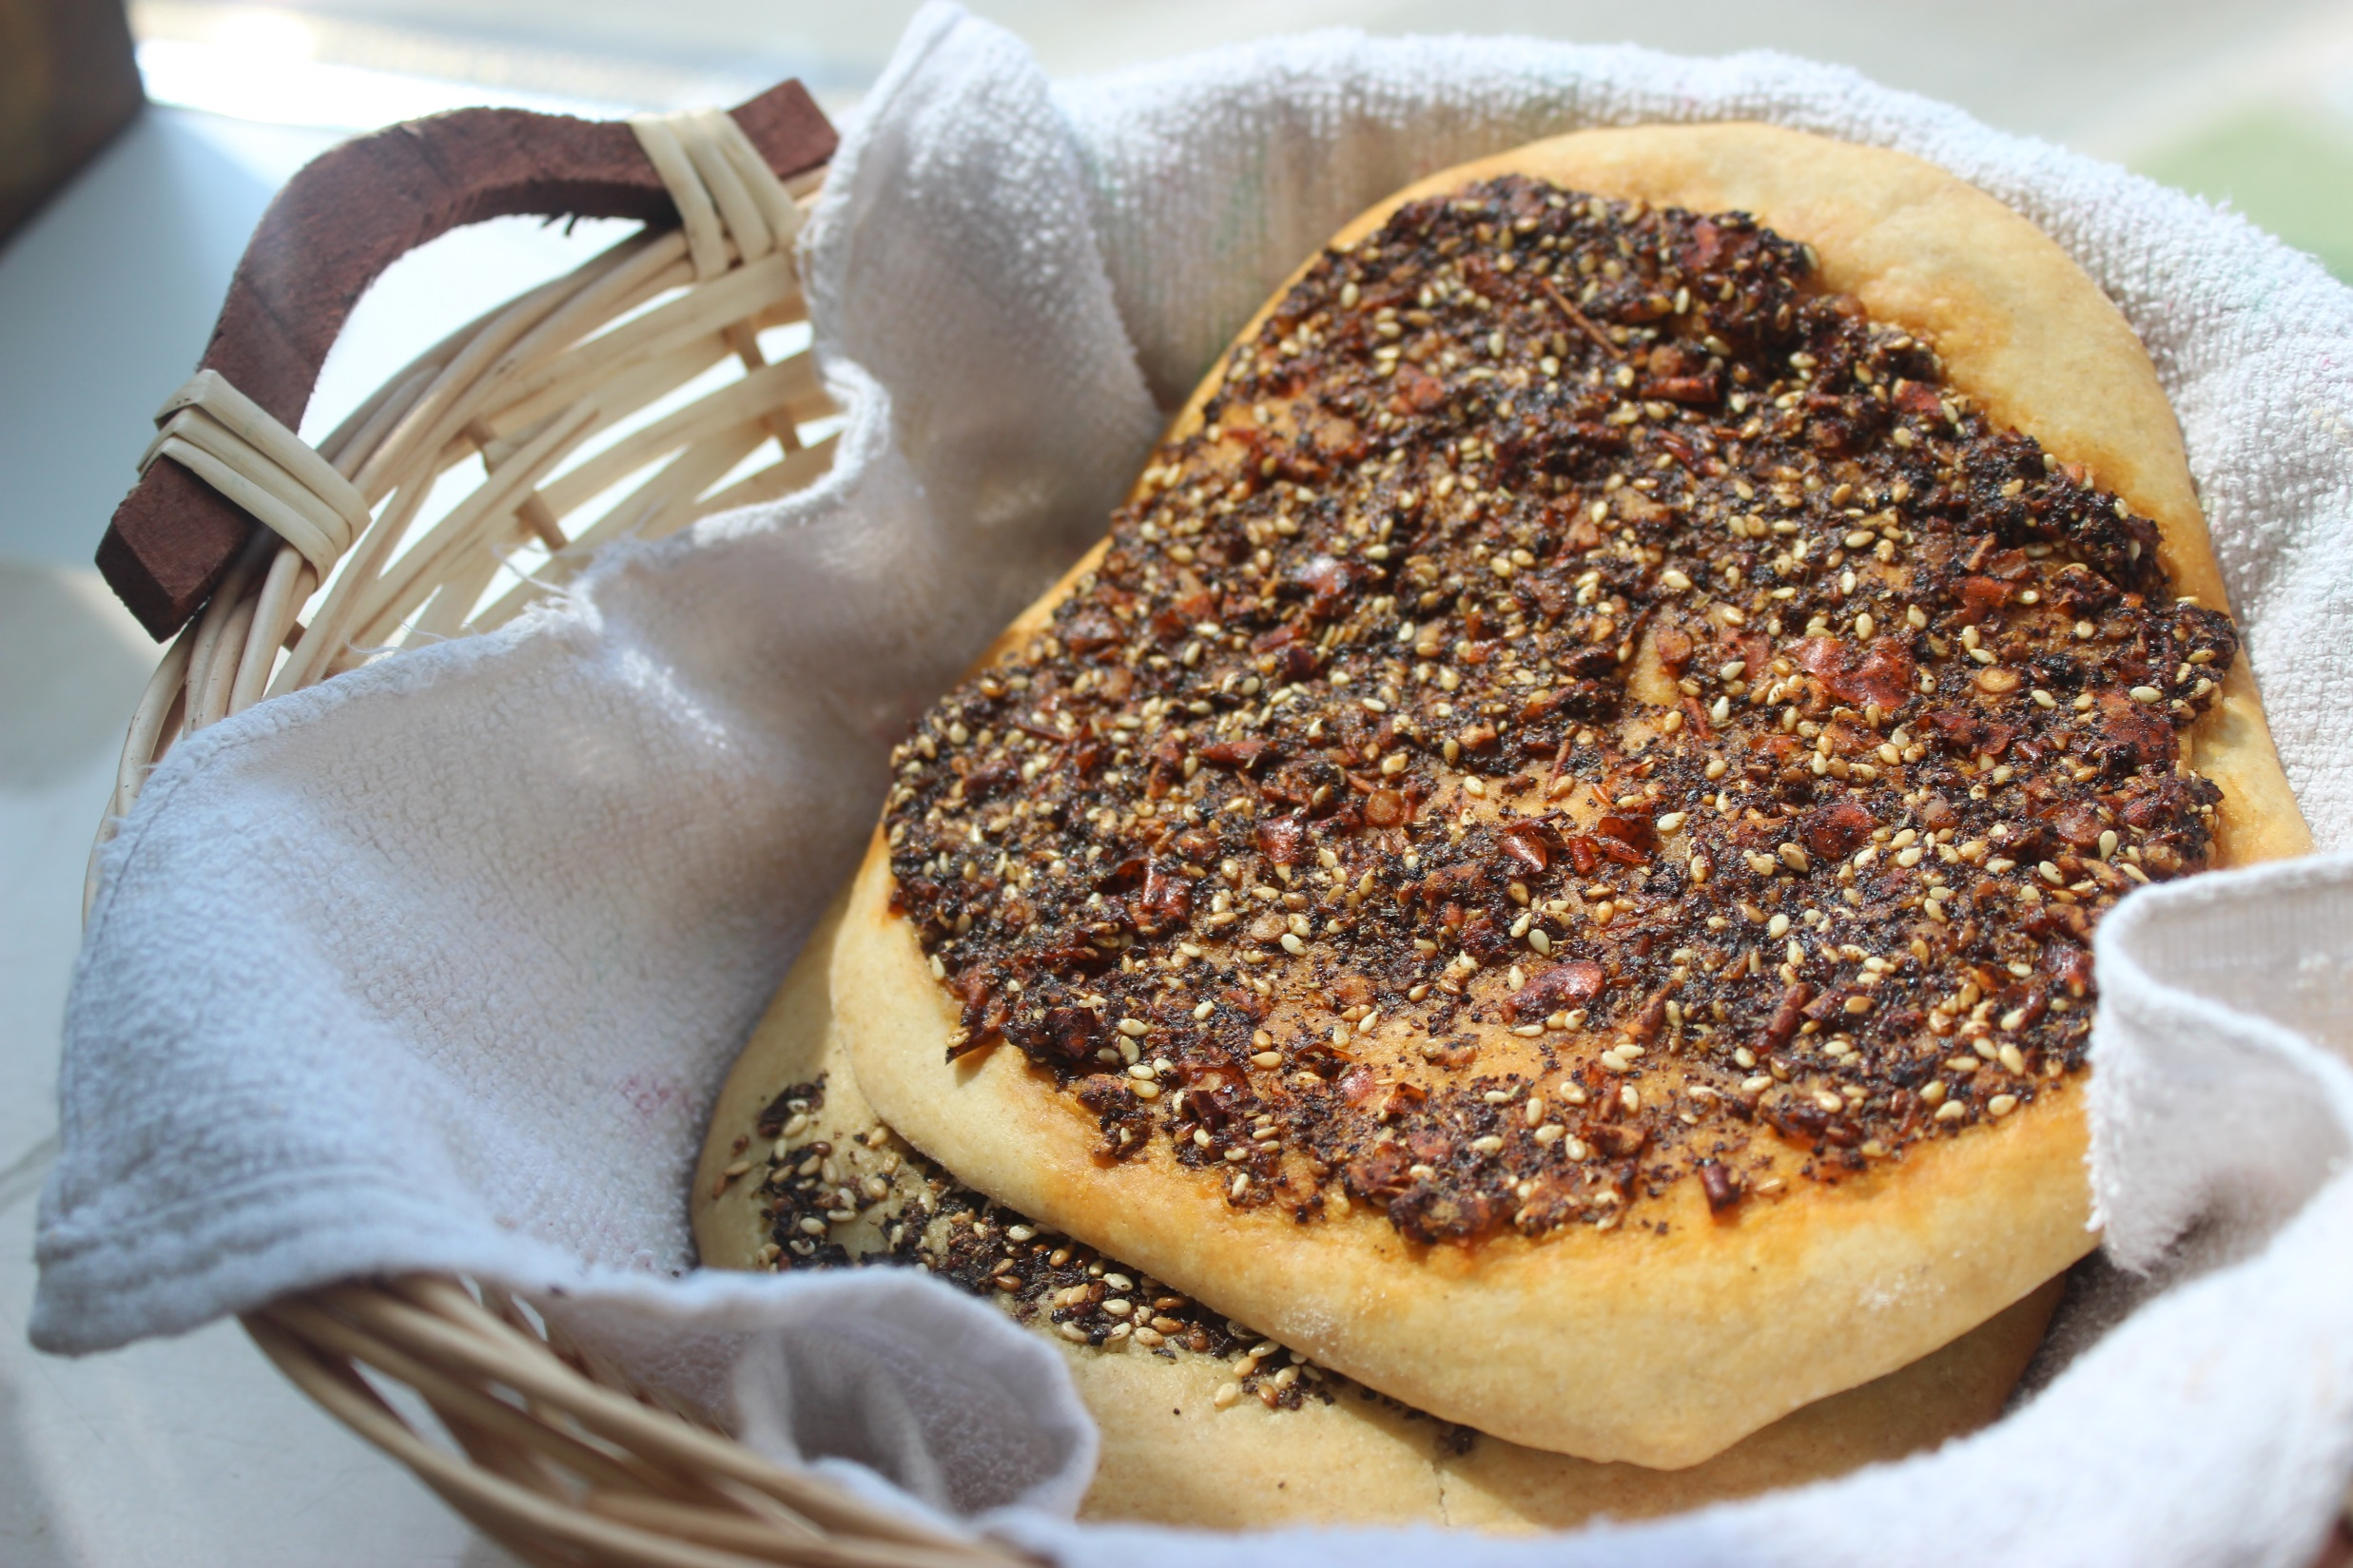

Slide 9
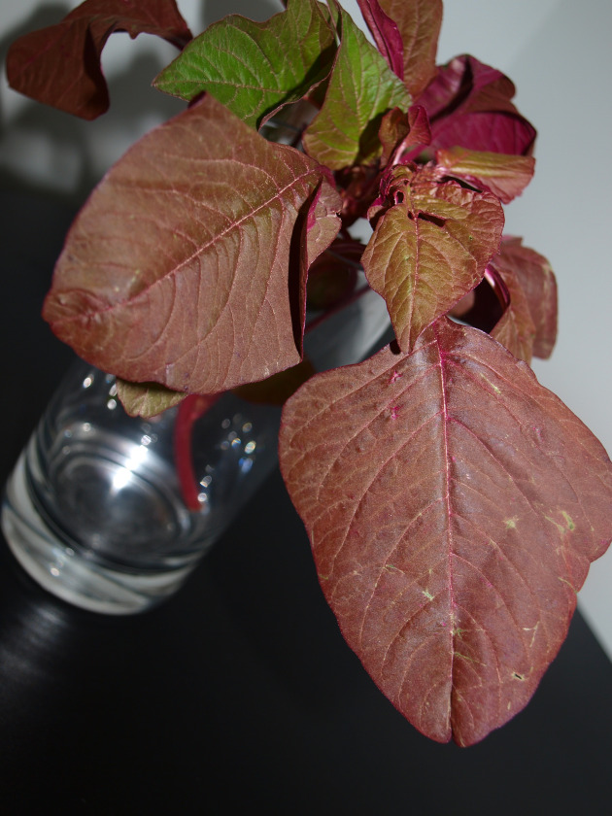
Amaranth Leaves
1070% percent daily value of Vitamin K in just 1 serving.
60% daily value of vitamin C…45% daily value of vitamin A…45% daily value of manganese…20% folate…15%calcium and magnesium.
High amounts of vitamin E, thiamin, niacin, iron, selenium, riboflavin, zinc, phosphorus, and copper!

Slide 10
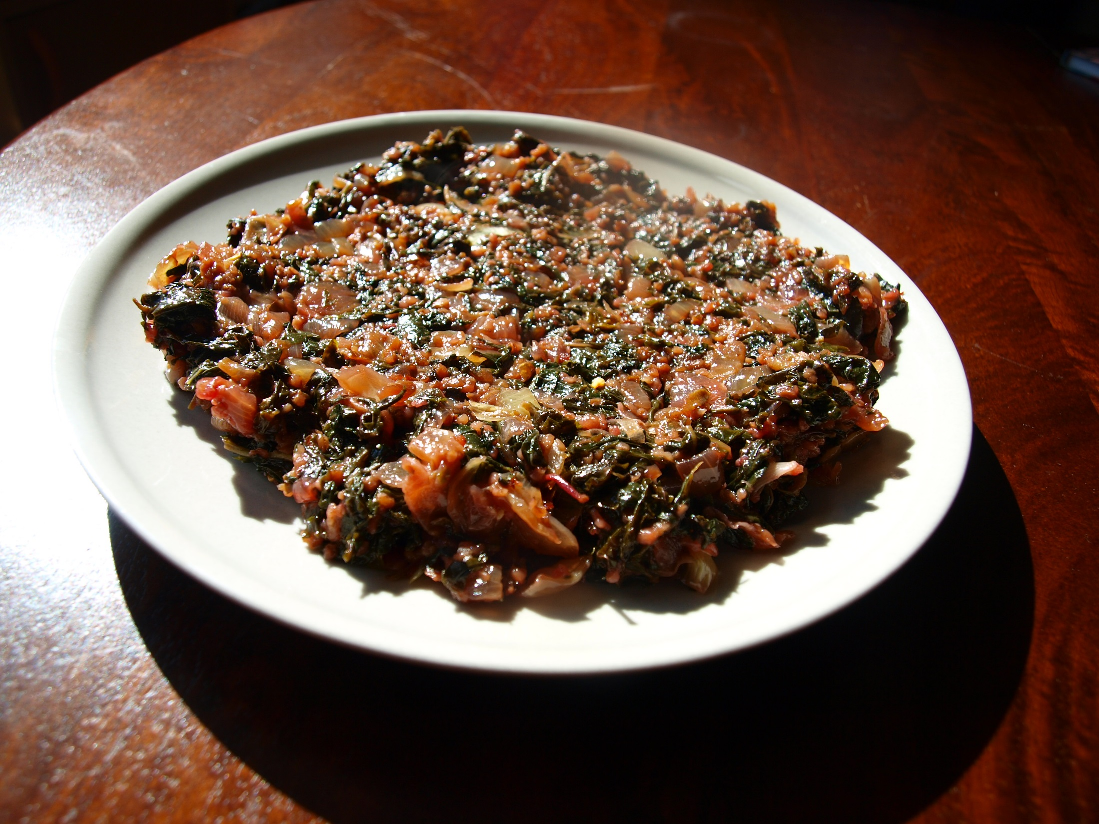
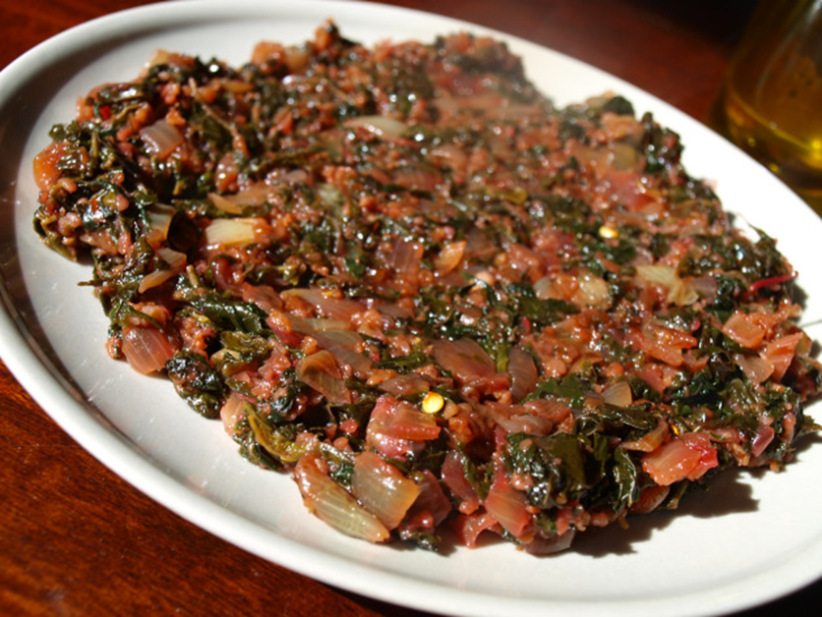

Slide 11
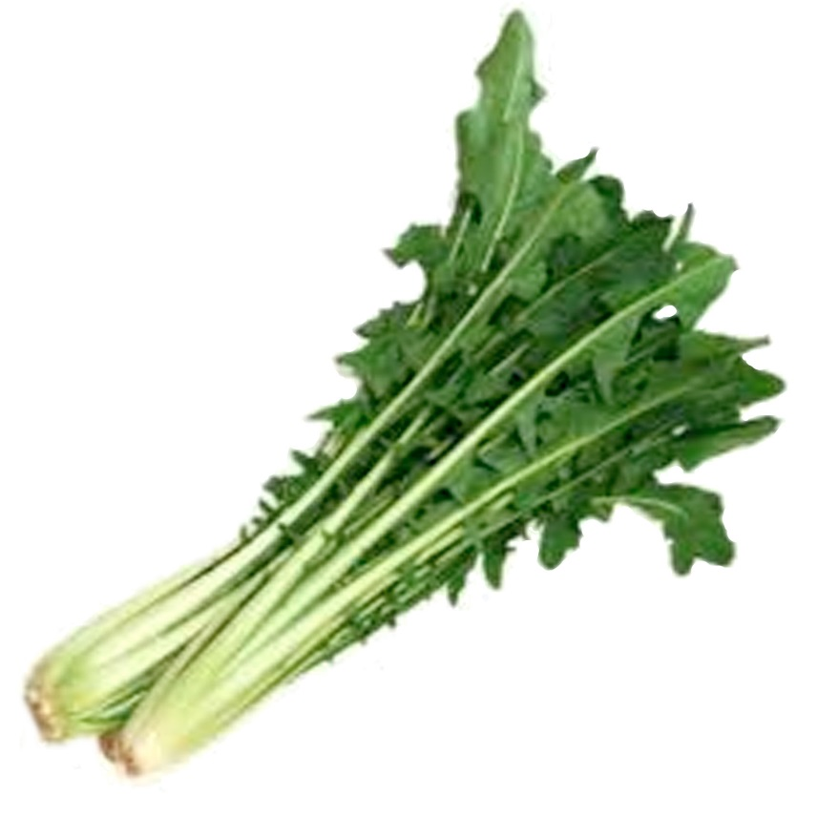
Chicory
High concentration of inulin—a probiotic
Maintains healthy “good” bacteria in the colon
Lowers cholesterol
Rich in Vitamins A, B6, C, E, and K
Stamnagathi

Slide 12
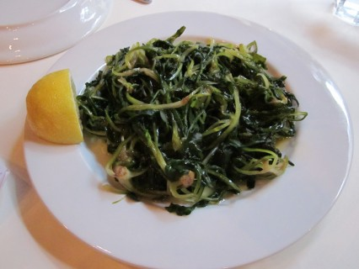

Slide 13
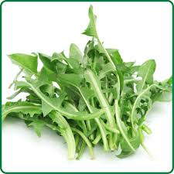
Dandelion Greens
Middle Eastern physicians in the 10th and 11th centuries used them as medicine
Settles digestion
Prevents gallstones, detoxifies liver
535% Vitamin K (strengthens bones, prevents Alzheimers)
112% Vitamin A (skin, mucous membranes, vision)
Flavonoid “zeaxanthin” (protects retina from UV rays
Carotein, Lutein, Cryptoxanthin (protects against lung/mouth cancers)
Vitamins C, B6, B1, B3, calcium, iron, potassium, manganese, folate, magnesium, phosphorus, and copper.
Tea: Diuretic, reduces stress

Slide 14
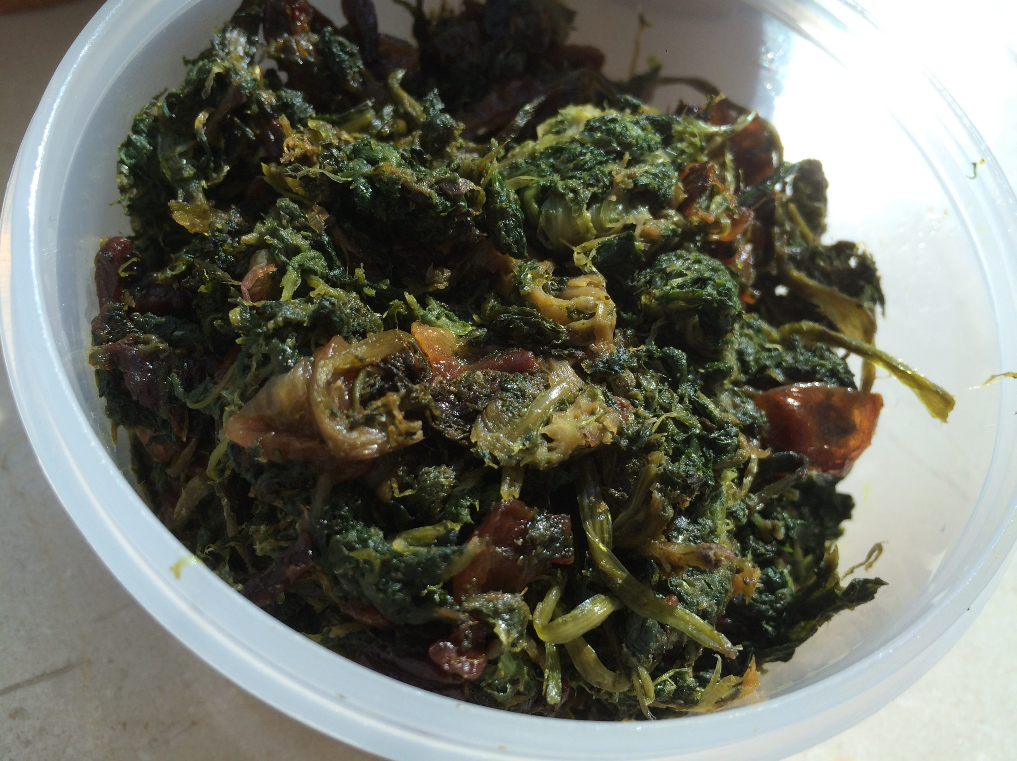

Slide 15
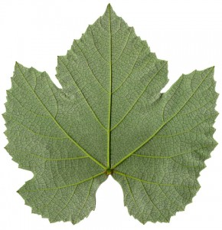
Grape Leaves
14 kcal/ 5 leaves
Vitamins C, E, A, K, B6, B3, B2, folate, calcium, magnesium, copper, and manganese.
Anti-inflammatory
Reduces edema in people with chronic venous insufficiency.
Treatment of: diarrhea, uterine hemorrhage, canker sores, hepatitis, stomach aches, and thrush.
Omega-3
Antioxidants: phenols, flavonois, flavonols, stilbenes
Antimicrobial (E-coli, Salmonella Infantis, Stapyloccocus aureus…)

Slide 16
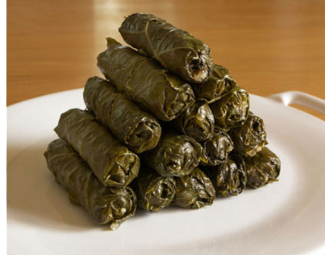

Slide 17
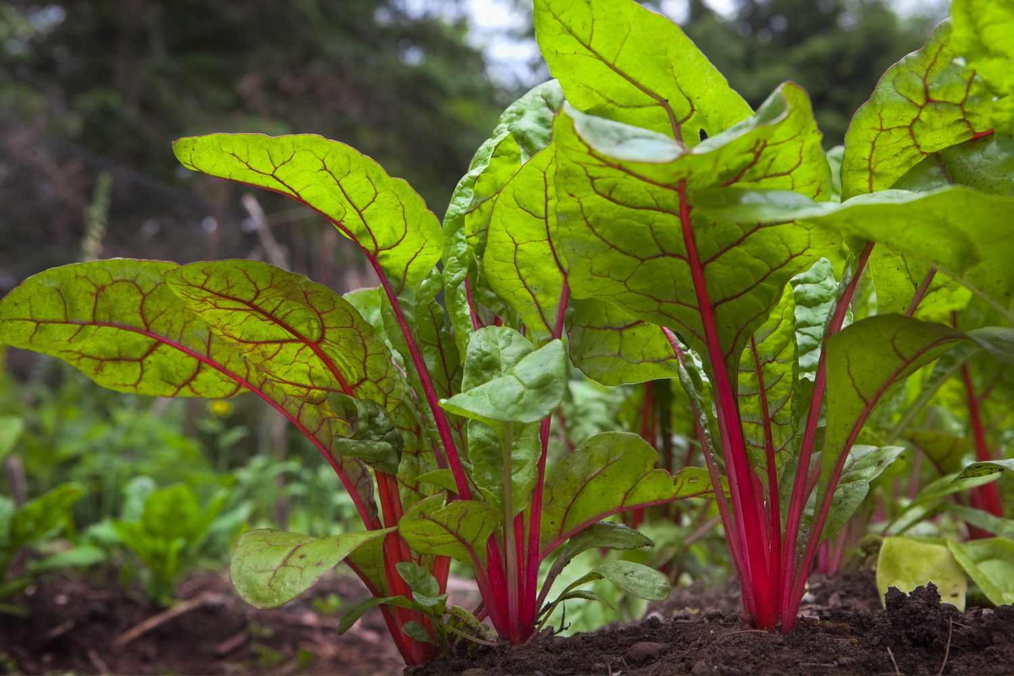
Chard
The Greek philosopher, Aristotle wrote about chard in the fourth century B.C. This is not surprising given the fact that the ancient Greeks, and later the Romans, honored chard for its medicinal properties.
kaempferol, the cardioprotective flavonoid that's also found in broccoli and kale.
Syringic acid , a flavonoid shown to keep blood sugar stay more steady.
Contains betalain phytonutrients that provide antioxidant, anti-inflammatory, and detoxification support.
An excellent source of vitamin C, vitamin E, vitamin A (in the form of beta-carotene) and the mineral manganese, and a good source of the mineral zinc.
Antioxidants beta-carotene, lutein, and zeaxanthin to flavonoids like quercetin and kaempferol.
Calcium and its excellent supply of magnesium and vitamin K, providing good bone support.

Slide 18
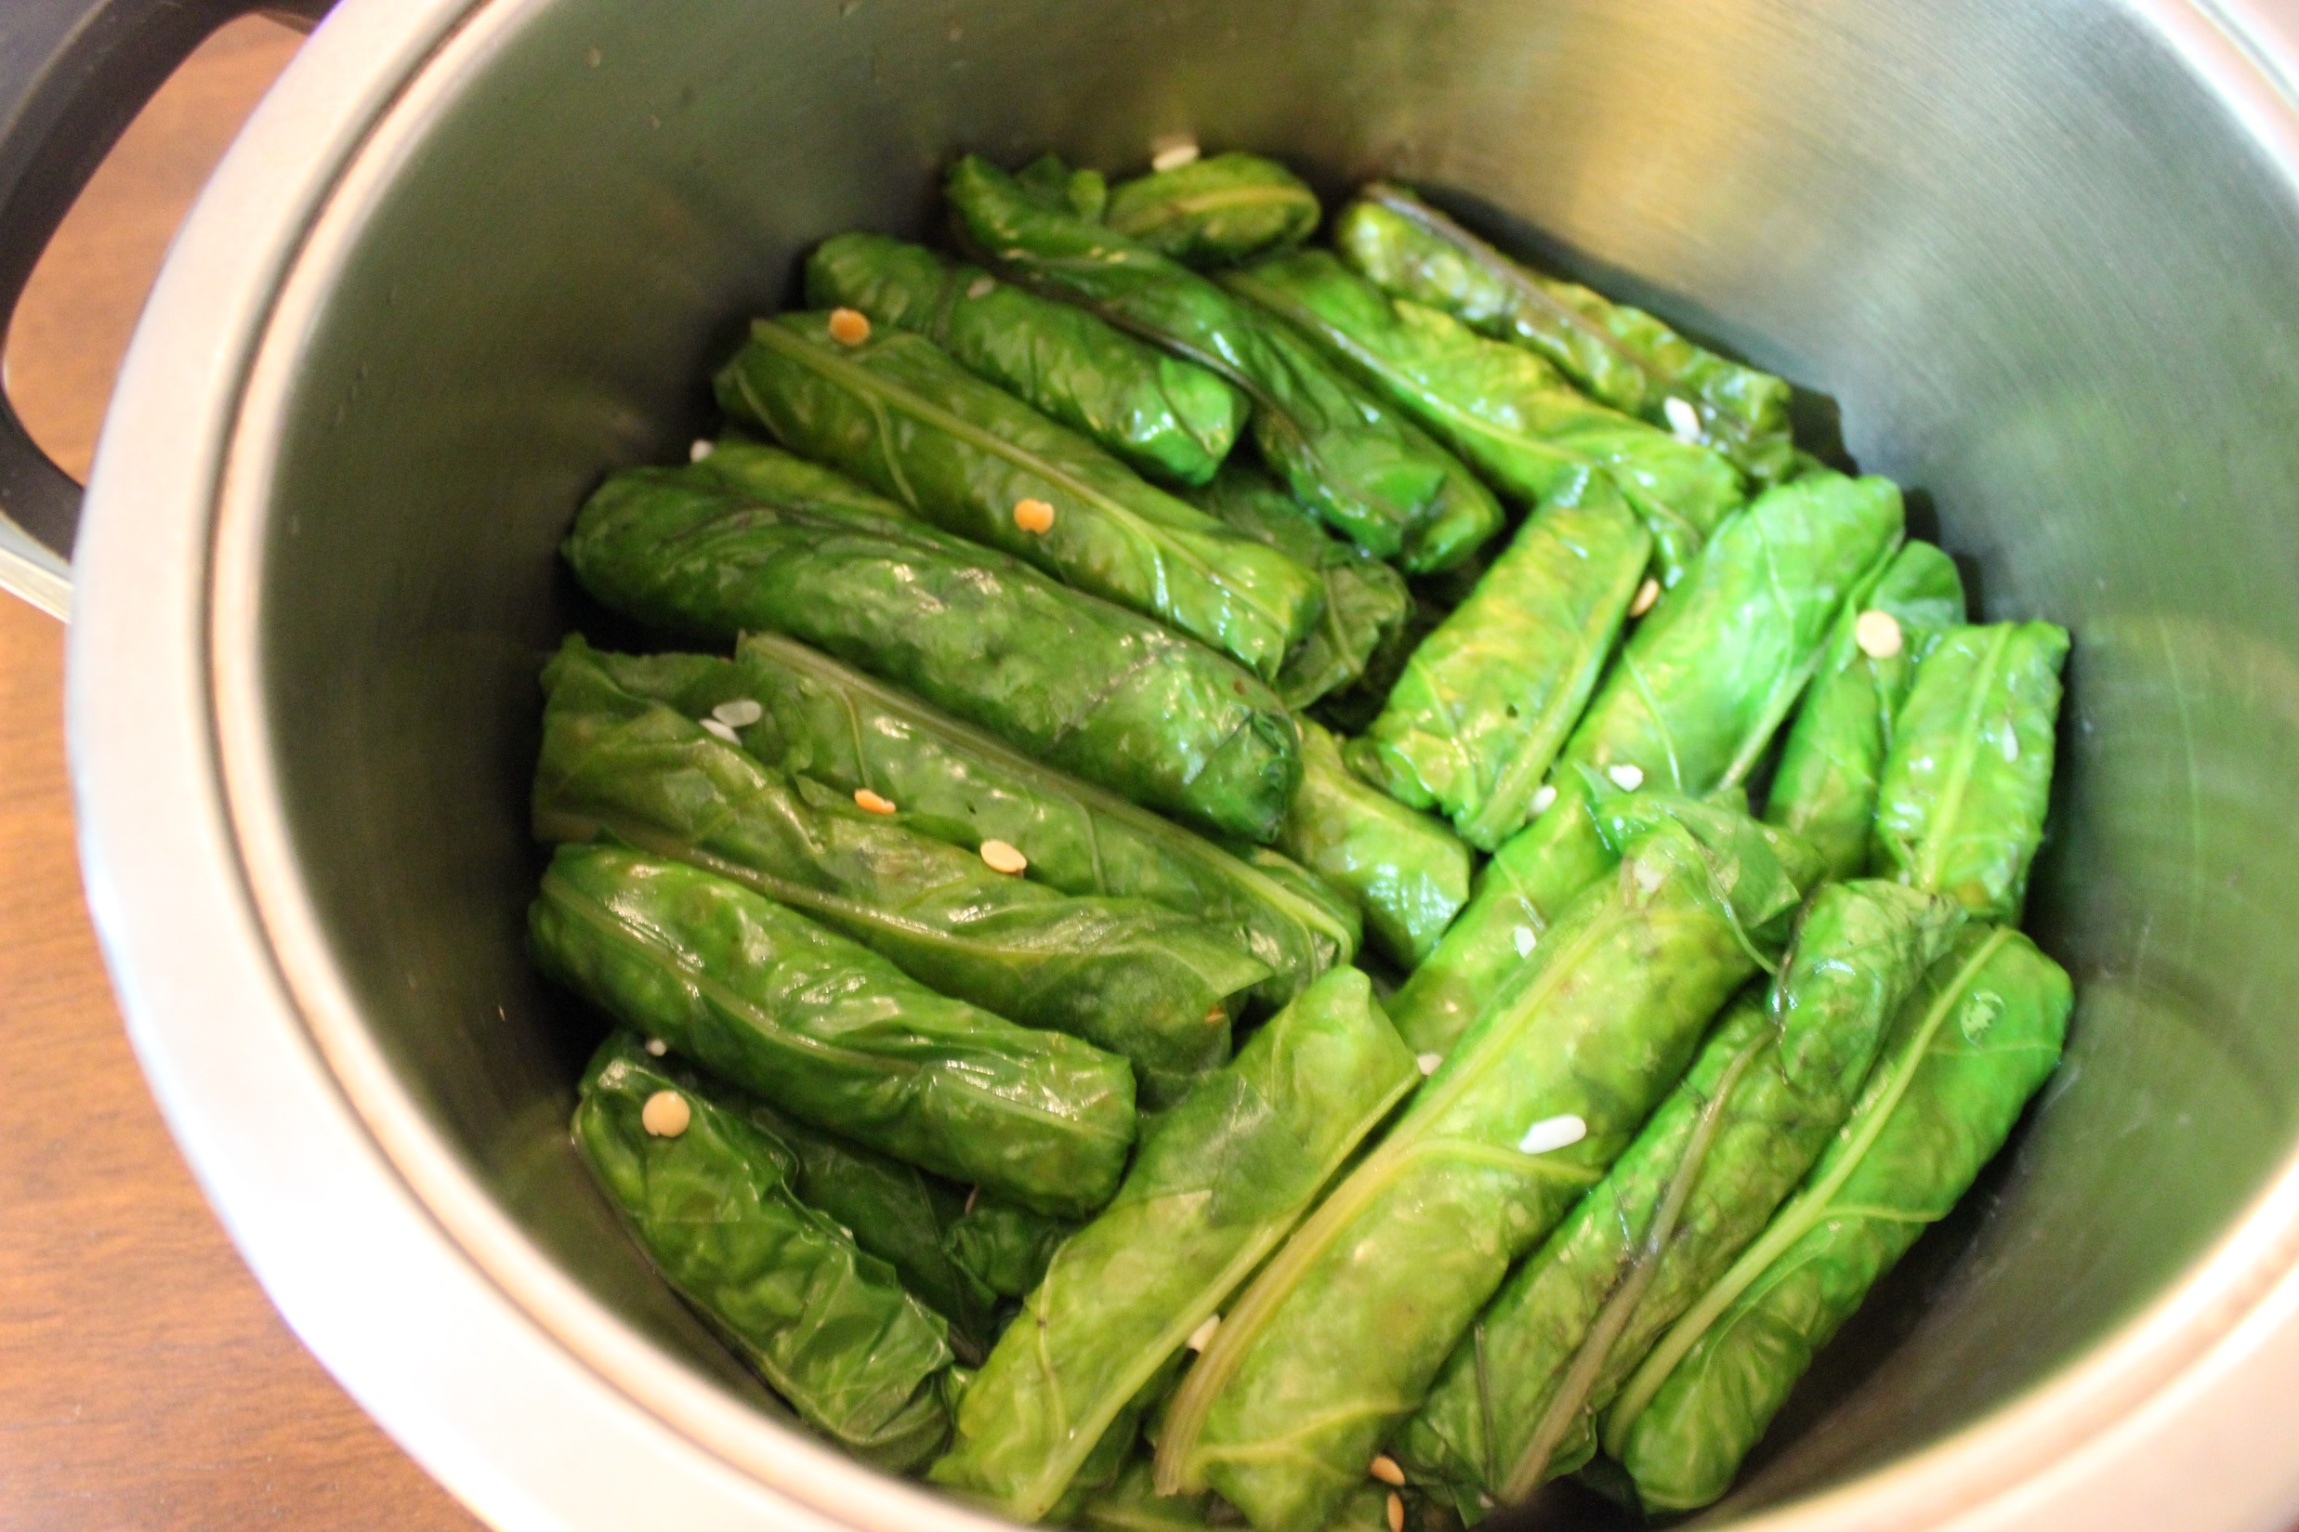

Slide 19
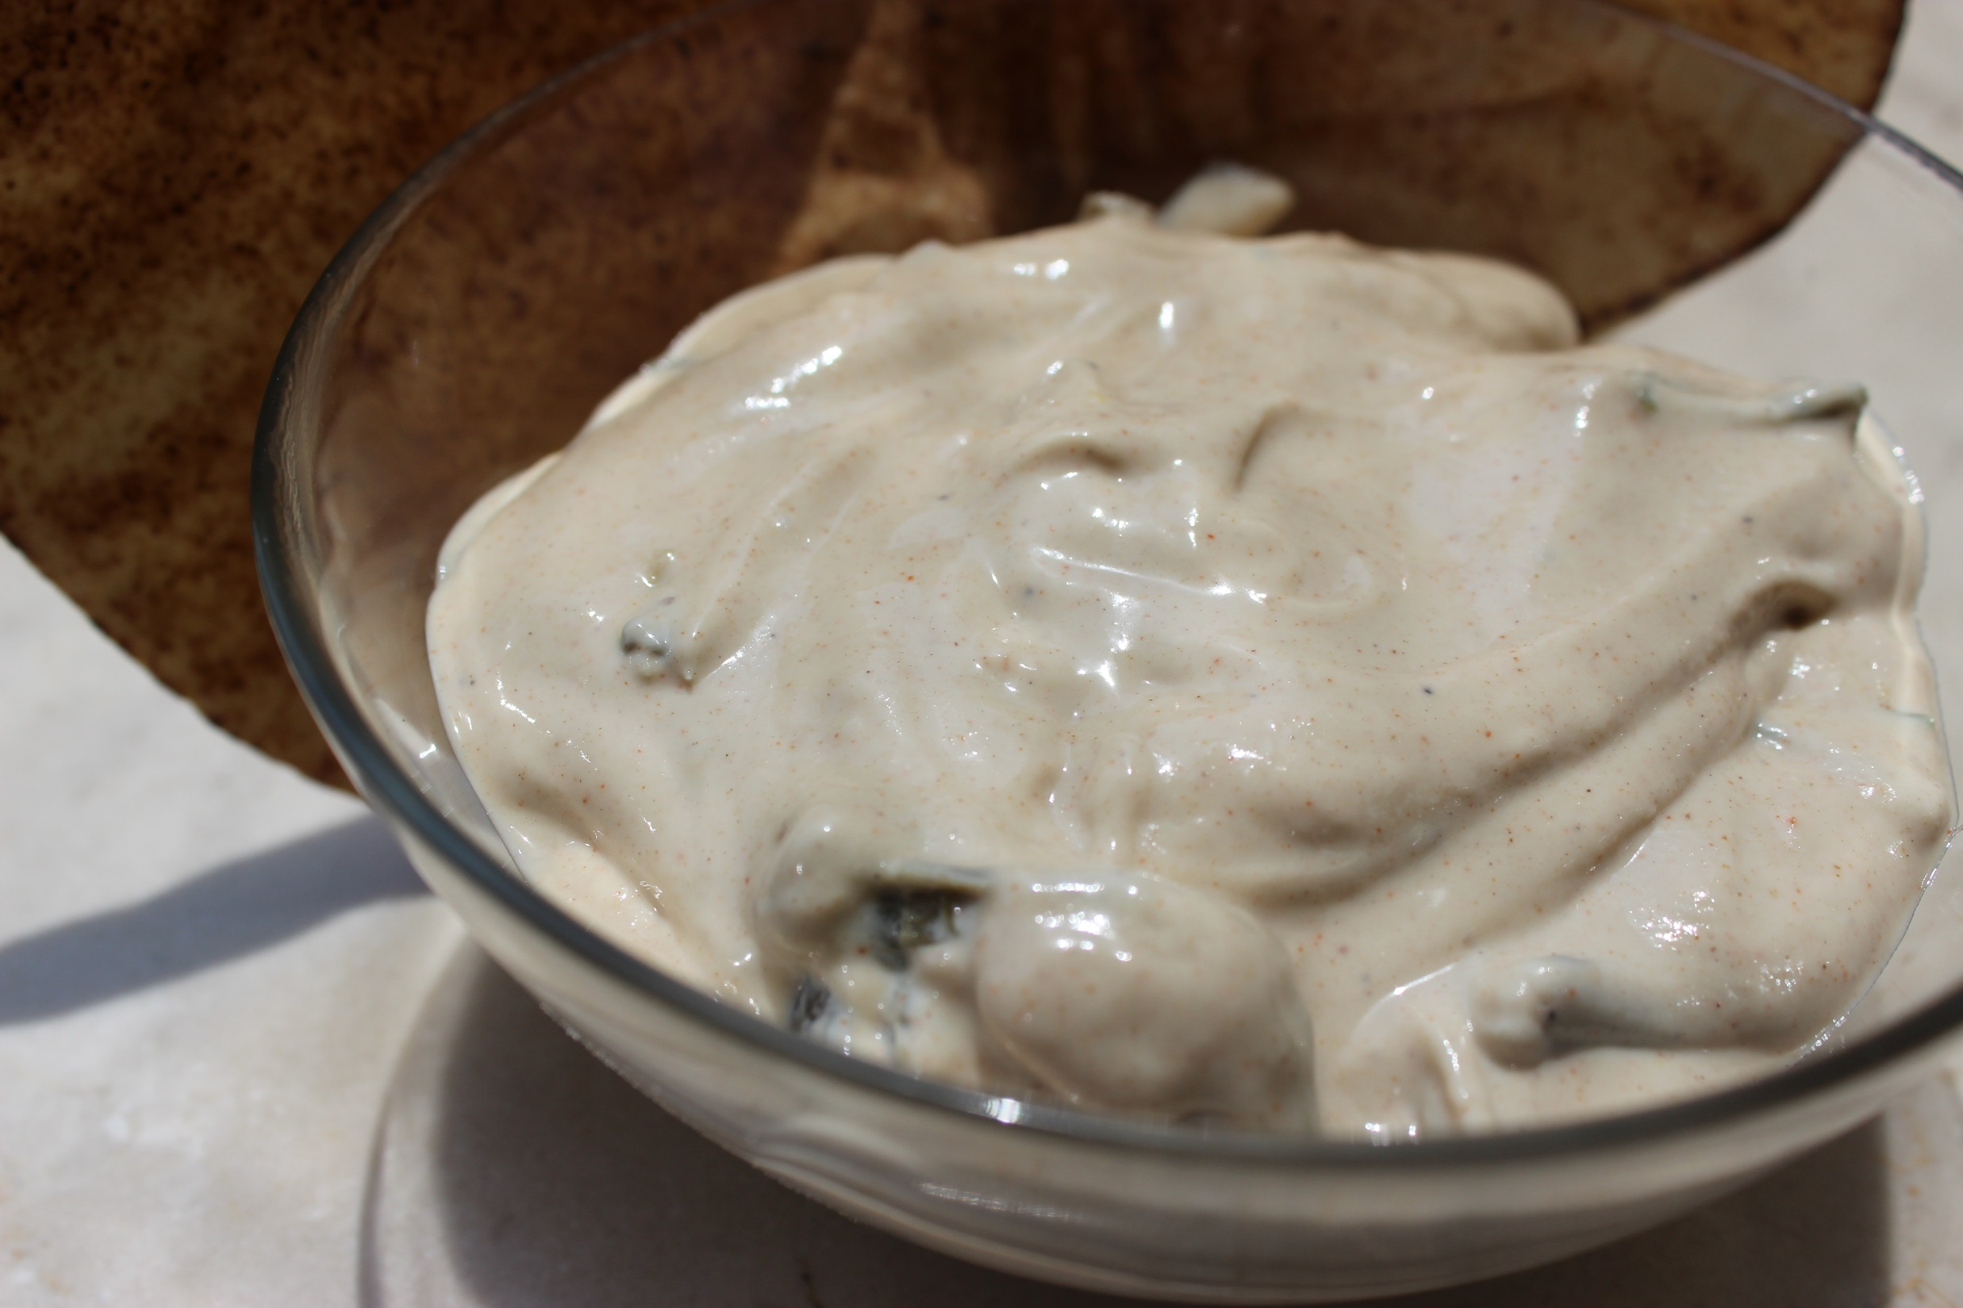

Slide 20
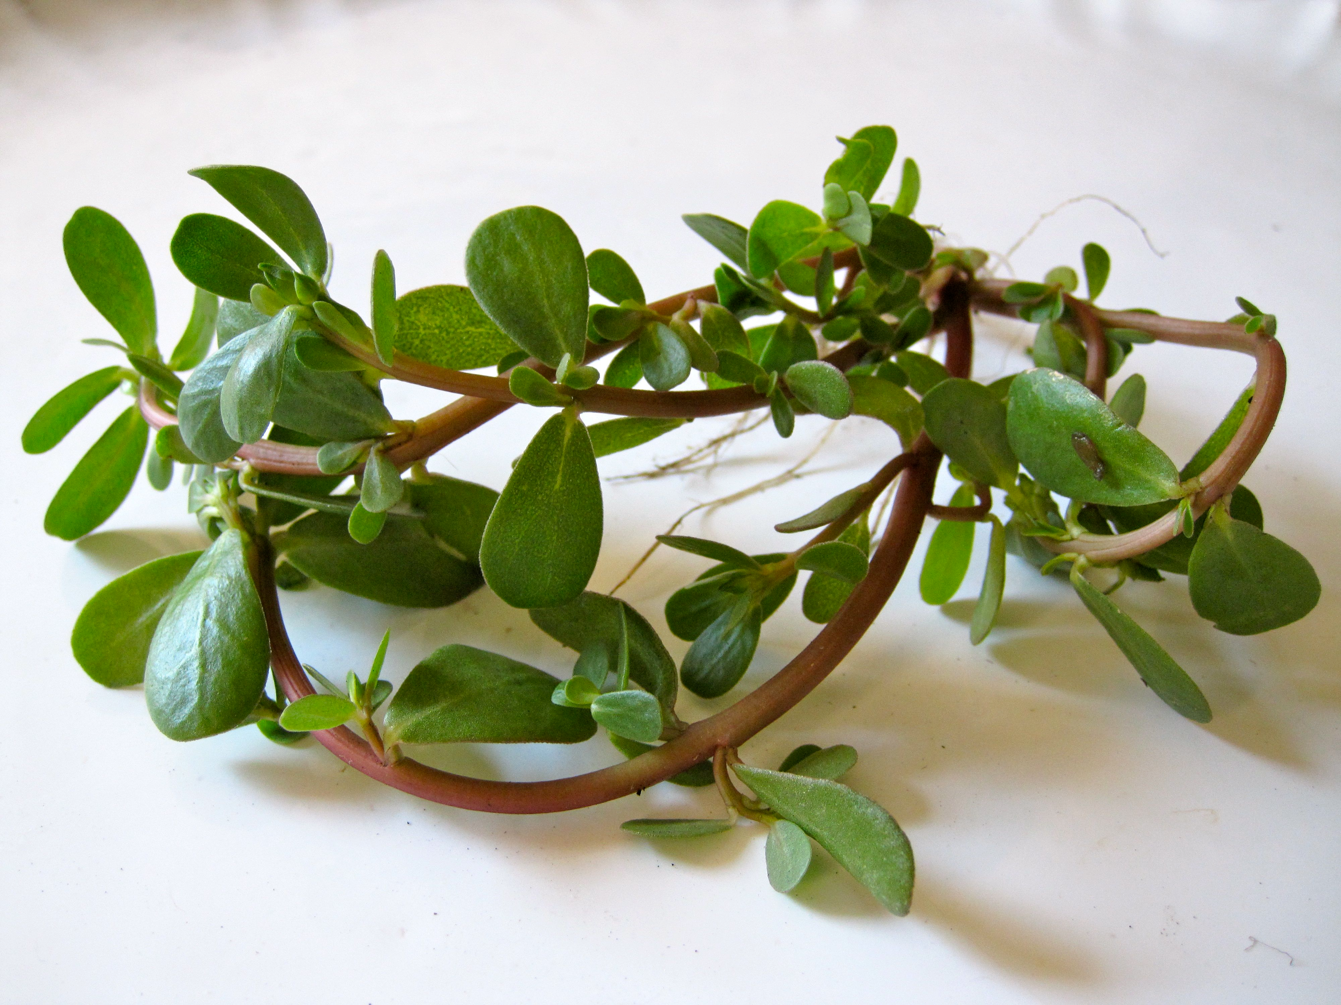
Purslane
The richest source of omega-3 fatty acids among green leafy vegetables.
Alpha-linolenic acid, or ALA (promotes longevity and low rates of heart disease), which controls platelet function, endothelial cell function, inflammation, arterial compliance, and arrhythmia.
pro-vitamin A, vitamin E, and vitamin C. One cup of raw purslane provides 15% of the daily value for vitamin C and 11% of the daily value for vitamin A.
Calcium, magnesium, potassium, and iron.

Slide 21
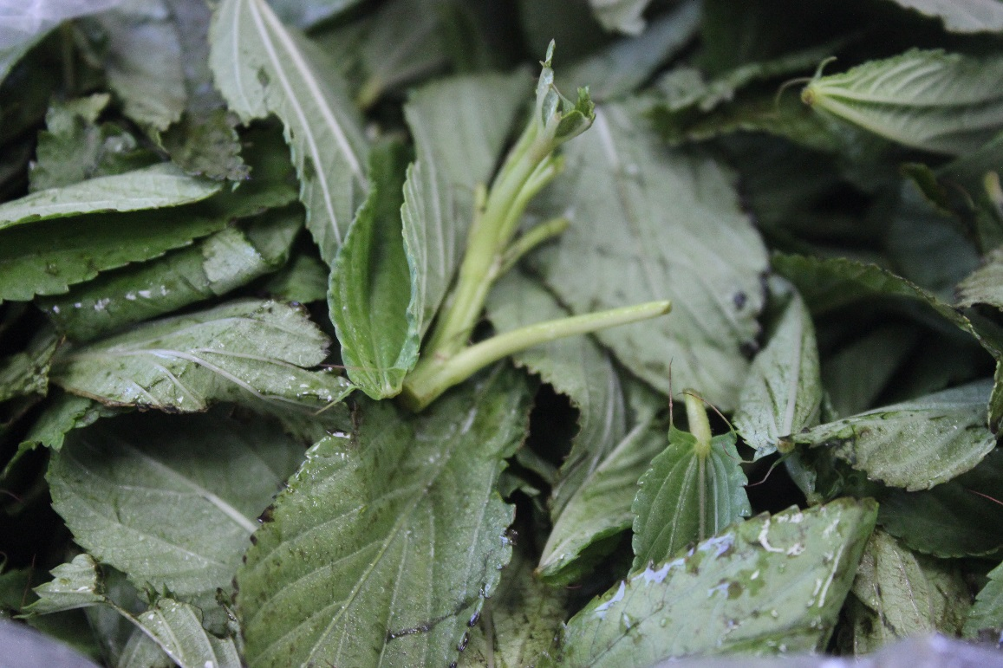
Jute, or Egyptian Spinach (Molokhia)
Chock full of calcium and iron
Carotene: 4.6 times more than spinach and 19 times more than broccoli.
Calcium: 9 times more than spinach and 10 times more than broccoli.
B1 and B2: 5 times more than spinach.
Highest content of Vitamin E, C, potassium, and iron.
Demulcent, diuretic, febrifuge and tonic
Cholesterol-lowering soluble fiber.

Slide 22
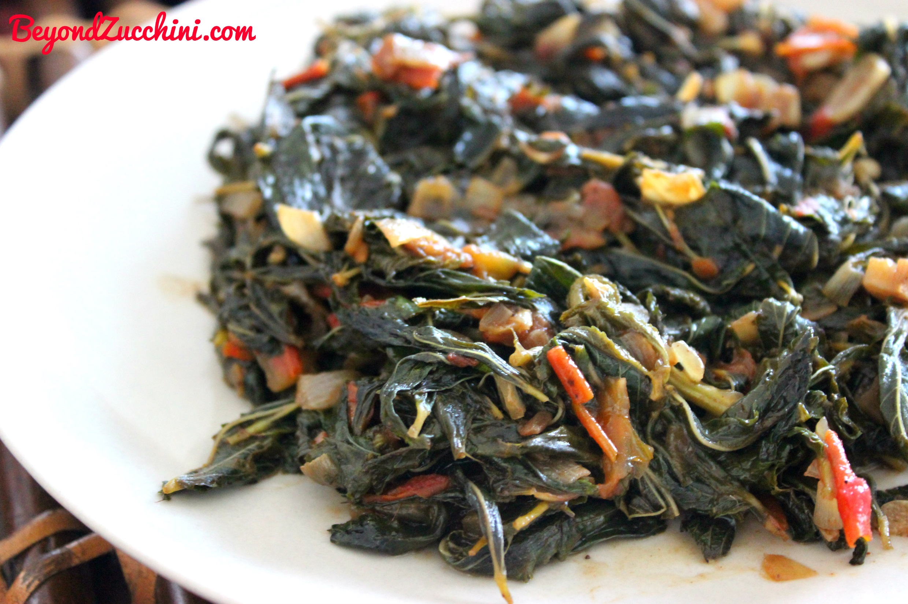

Slide 23
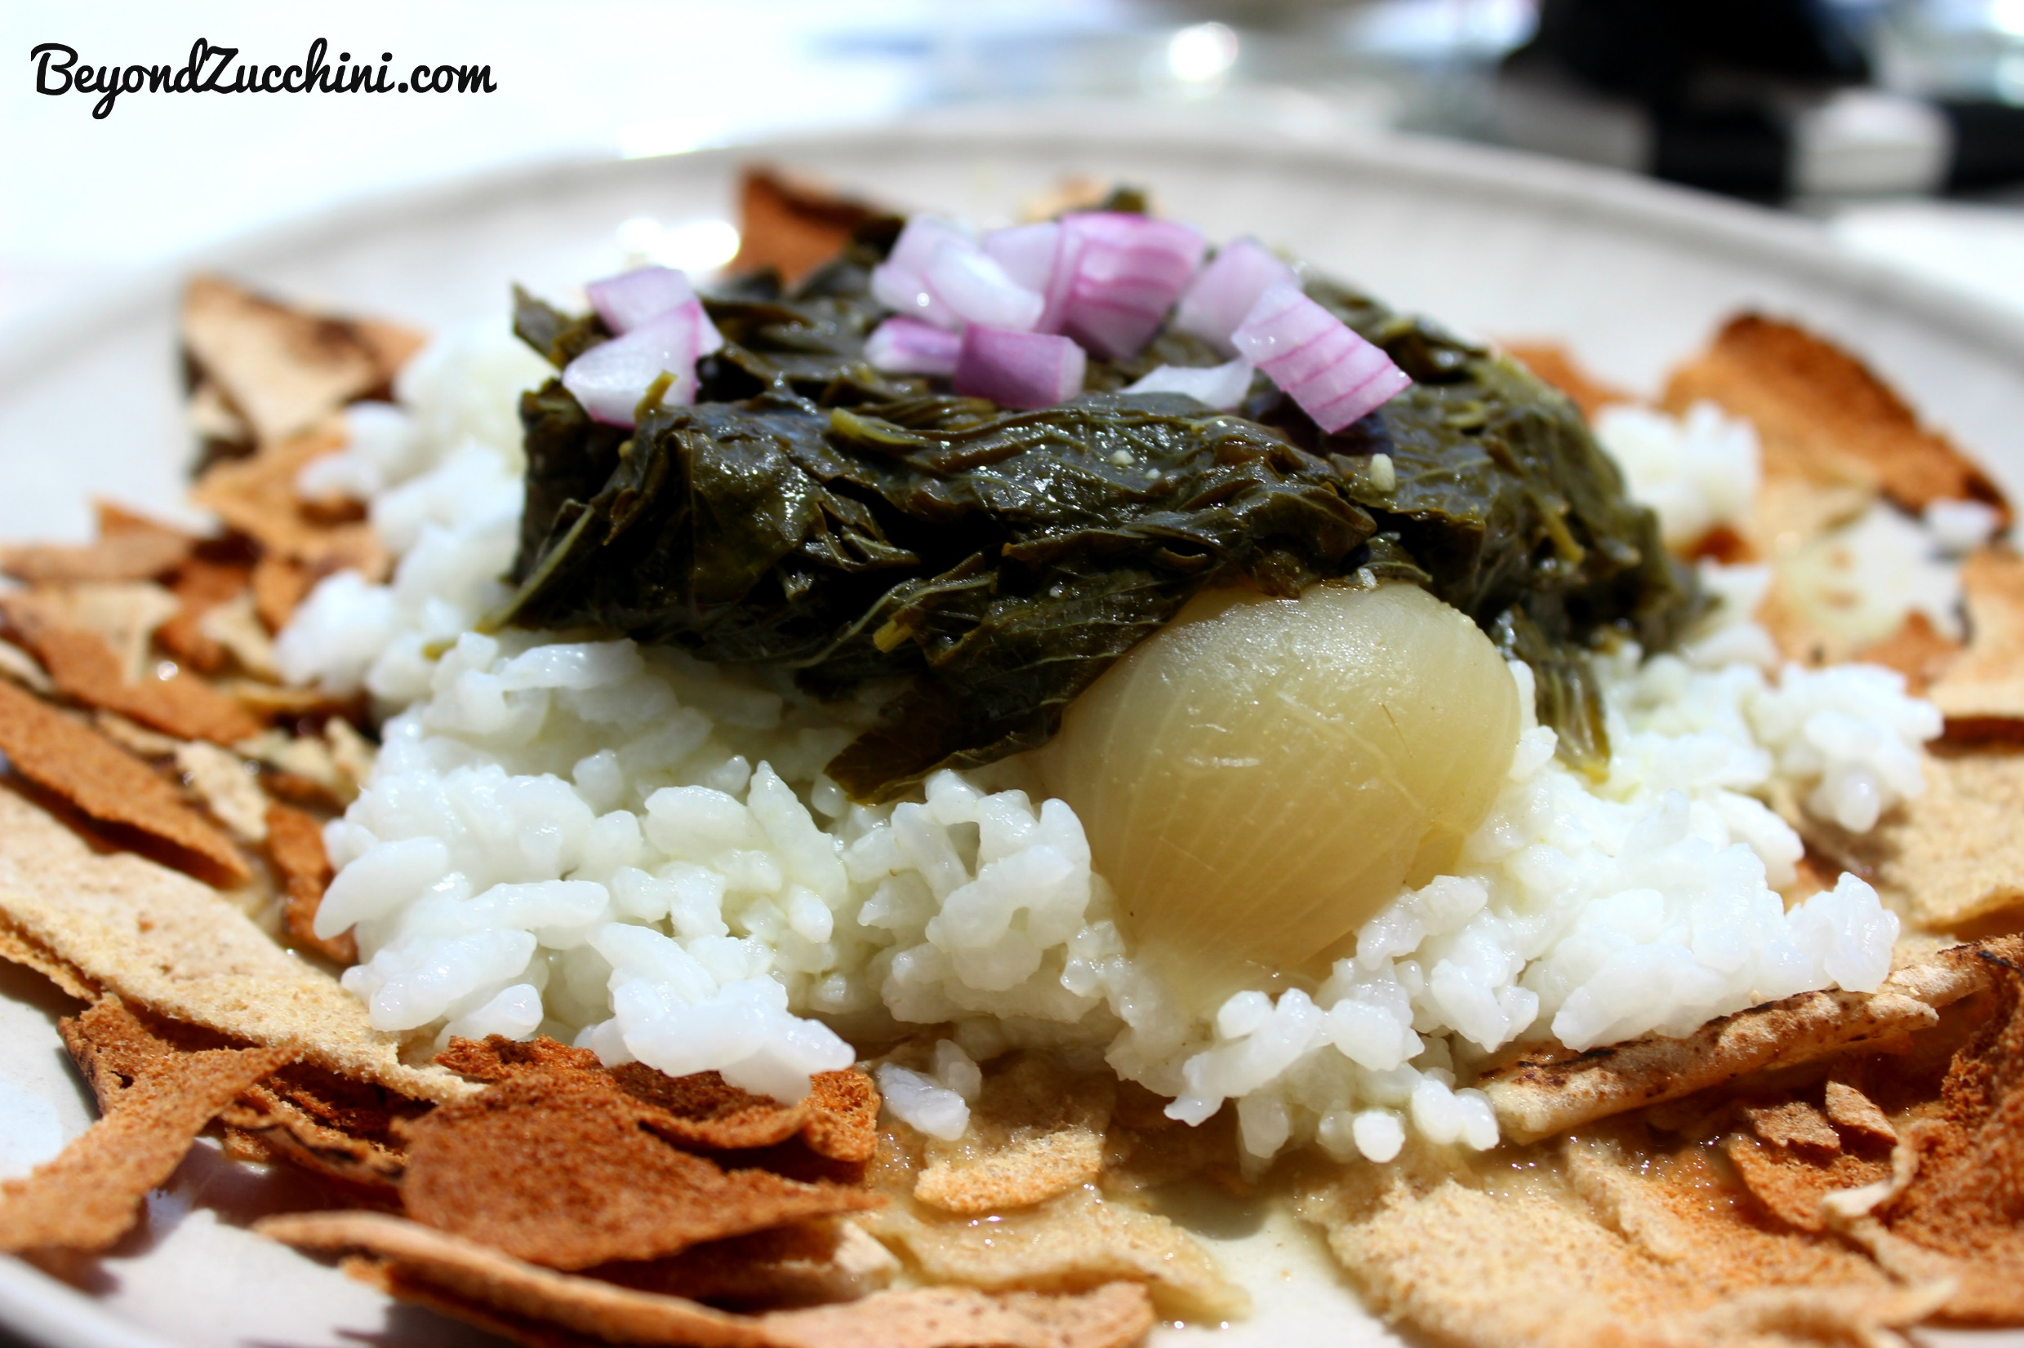

Slide 24
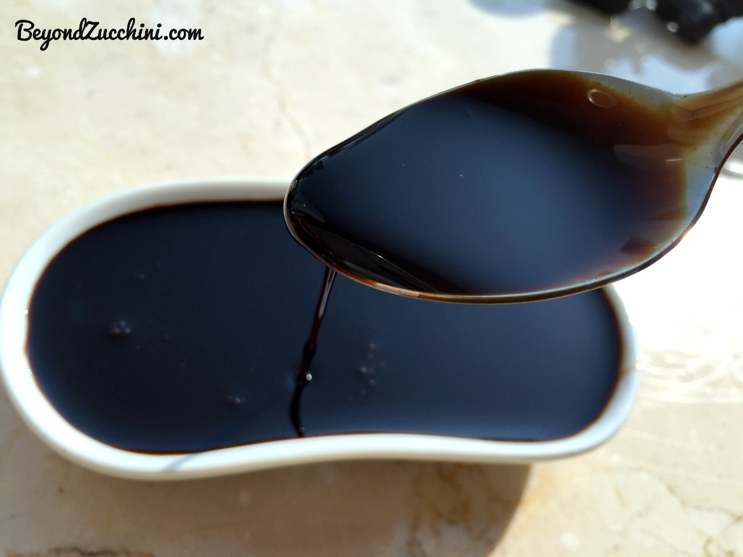
Pomegranate Molasses
Antioxidants (polyphenols) can reduce low-density lipoproteins
may prevent or slow the accumulation of cholesterol in your arteries
B vitamins including B1, B3, B5 and B6.
Vitamin C

Slide 25


Slide 26
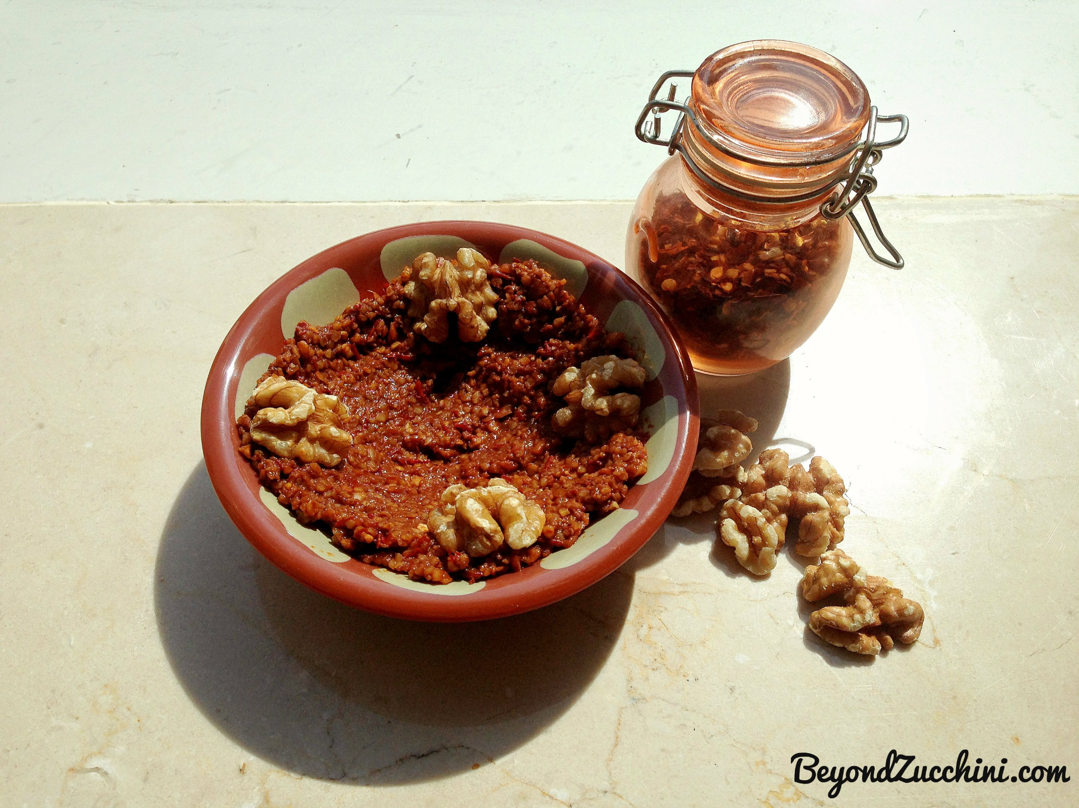

Slide 27
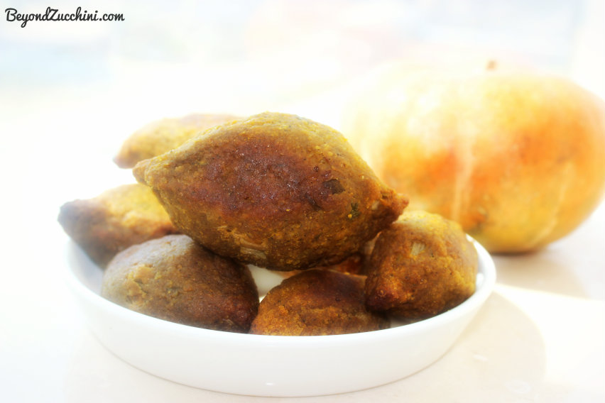

Slide 28
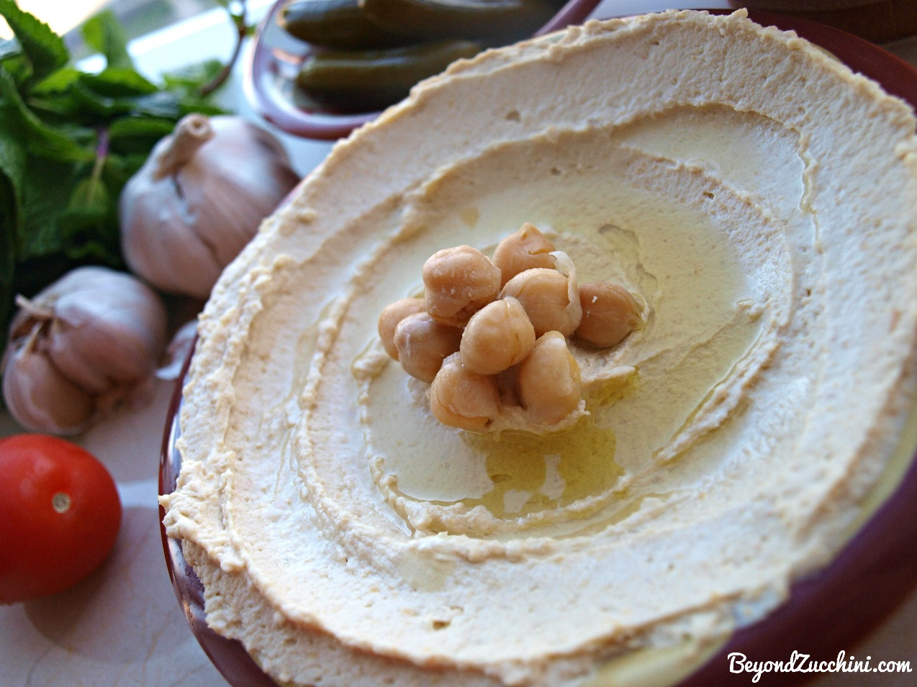
Tahini
Phosphorus, lecithin, magnesium, potassium and iron
Methionine (liver detoxification)
High in vitamin E and vitamins B1, B2, B3, B5 and B15.
20% complete protein (higher protein source than most nuts).
Rich in both MUFA’s and PUFA’s
Calcium, calcium, calcium!

Slide 29
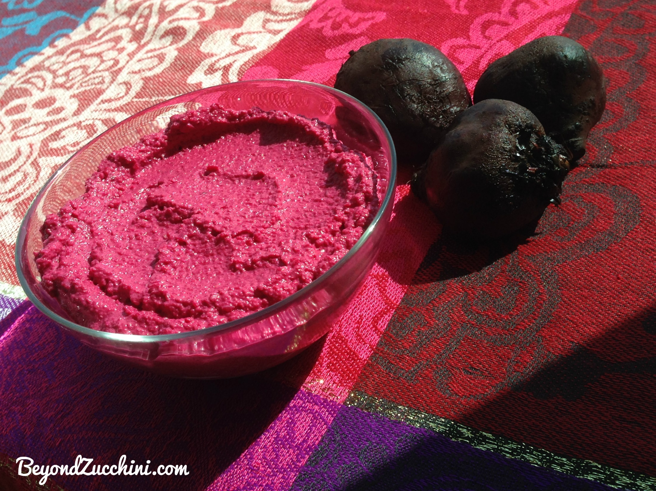

Slide 30



www.beyondzucchini.com
Facebook: https://www.facebook.com/beyondzucchini
Instagram: Beyond_Zucchini
Twitter: @BeyondZucchini

